Slide 1
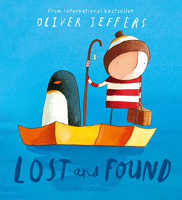
Understanding the World
This teaches us about the environments that we share with others, including their homes, school and places in the local community. We will talk about ourselves and how we have changed over time, from babies to children.
We will discuss our nursery environment and how we care and respect it.
Physical Development
We will be learning to ….
developing our fine motors through activities to support a comfortable pencil grip.
experimenting with different ways of moving our bodies and begin to remember sequences and patterns of movement.
Expressive Arts and Design
This half term we will be …….
we will be exploring how to use the creative area, accessing the available resources and how to use the tools for the correct purpose.
we will learn nursery rhymes and the actions to them.
We will explore colour and application of paint using a range of different tools.
Me and My
Community
Personal, Social and Emotional
Development
To settle into their new nursery environment, forming relationships with their teachers and separating from their parent/carer with confidence. We are learning how to use the calm corner to begin to learn how we feel. We are using the feelings monster to begin to identify our feelings.
Communication and Language
This half term we will be…..
Developing storylines in their pretend play and use talk to help work out problems and organise thinking and activities.
Asking questions to find out more and understand what has been said to them.
Listening carefully in a range of situations and is aware of the importance of listening
Literacy- Reading and Writing
develop a preference in what hand to use and hold a pencil in a comfortable grip.
demonstrate awareness of what has been read to them by retelling stories in their play using props.
Mathematics
In Maths we will be exploring filling and emptying with a range of resources, looking at full and empty.
We will be using a range of construction blocks to explore building and placing one block on top of the other. We will begin to look at 2D shapes and 3D shapes.

